Slide 1
Pre-Talent Track Fall 2022
Hans-Jörg Schulz

Slide 2
What is the pre-talent track?
Any and all of the below – depending on how you want to use it:
a way to “pre-earn” ECTS points for the Talent Track starting in year 2
a means to dive into some pretty cool CS / IT topics for which there’s otherwise no room in our BSc curriculum
How to use security flaws to hack into a computer system?
How to analyze and visualize large datasets?
How to program by specifying what you want and letting the computer figure out how to do it?

Slide 3
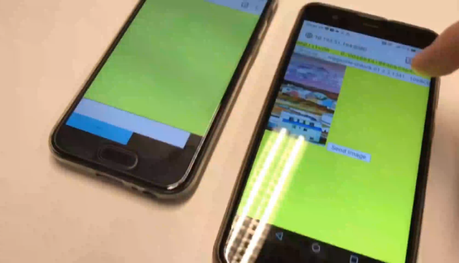
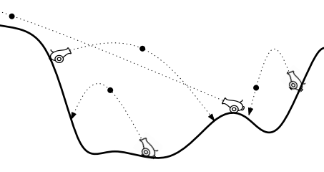
Even Wilder stuff in the spring – e.g.
acadbadcbadbcdacdbcbadadabcabdbcdbac…
Davenport-Schinzel Sequences and their applications to cannon shooting
Programming with sensors in mobile devices and using them for generating shared secrets for file exchange

Slide 4
What is the pre-talent track?
Any and all of the below – depending on how you want to use it:
a way to “pre-earn” ECTS points for the Talent Track starting in year 2
a means to dive into some pretty cool CS / IT topics for which there’s otherwise no room in the bachelor curriculum
an introduction to different technologies (Webstrates, D3.js, VEGA, Datalog,…)
an overview of the research groups and topics at our department
a new set of puzzles / mini challenges to solve each week
a possibility to meet like-minded CS / IT students

Slide 5
SCHEDULE FOR THIS SEMESTER
Hacking - Security in Practice, Pt.1-2 with Diego F. Aranha (dfaranha@cs.au.dk)
Week 39 - Thursday 29-SEP-2022, kl.10-12
Week 41 - Thursday 13-OCT-2022, kl.10-12
Data Mining and Visualization, Pt.1-2 with Ira Assent (ira@cs.au.dk) and me (hjschulz@cs.au.dk)
Week 43 - Thursday 27-OCT-2022, kl.10-12
Week 45 - Thursday 10-NOV-2022, kl.10-12
Logic Programming, Pt.1-2 with Magnus Madsen (magnusm@cs.au.dk)
Week 47 - Thursday 24-NOV-2022, kl.10-12
Week 49 - Thursday 08-DEC-2022, kl.10-12
To be held at auditorium 110 at Finlandsgade 6 (Building 5106).

Slide 6
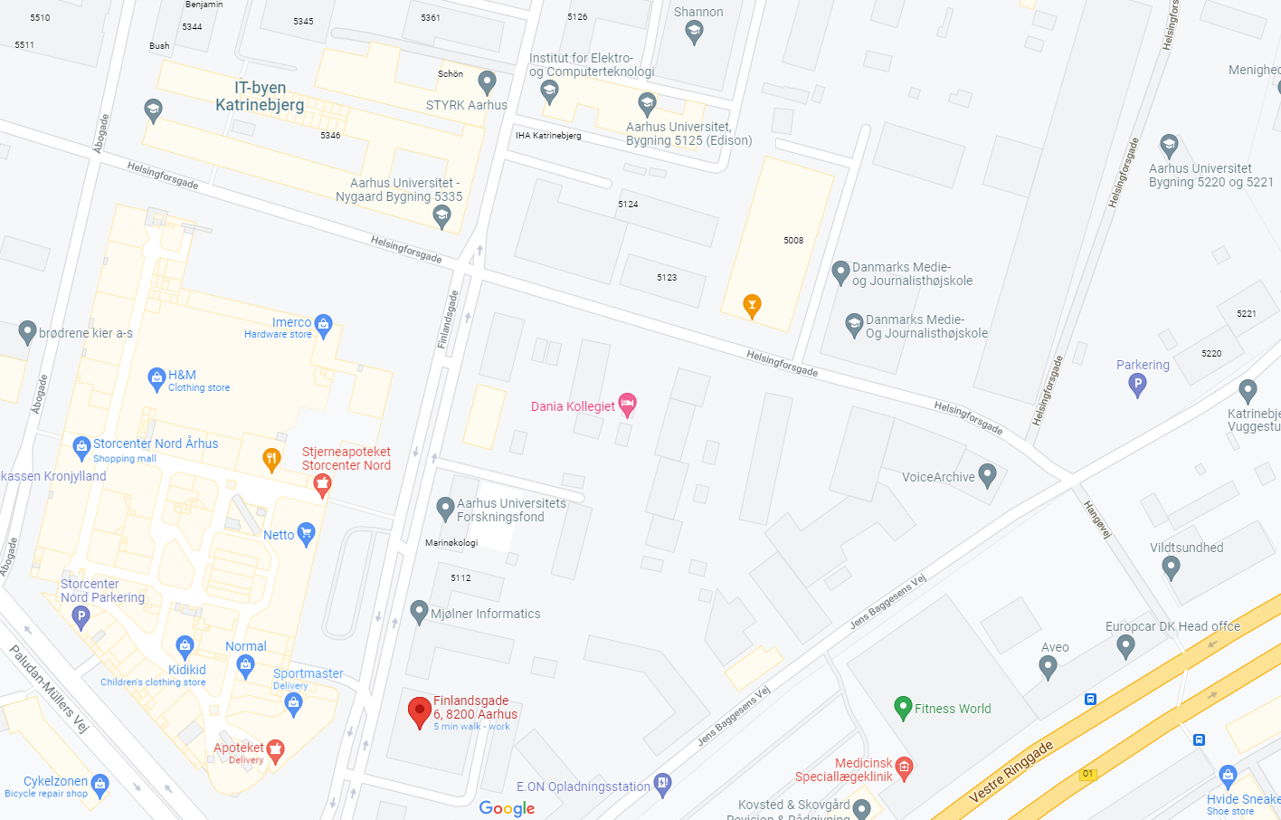

Slide 7
SIGN-UP REQUIRED!
You can follow the full program, or only selected lectures of interest to you.
You can hand-in the practical exercises or choose not to.
You can discontinue the pre-talent track at any point if your time does no longer permit for it or your course work becomes more demanding.
If you want the ECTS points for later, you have to follow through, though.
To participate, self-enroll on Brightspace!

Slide 8
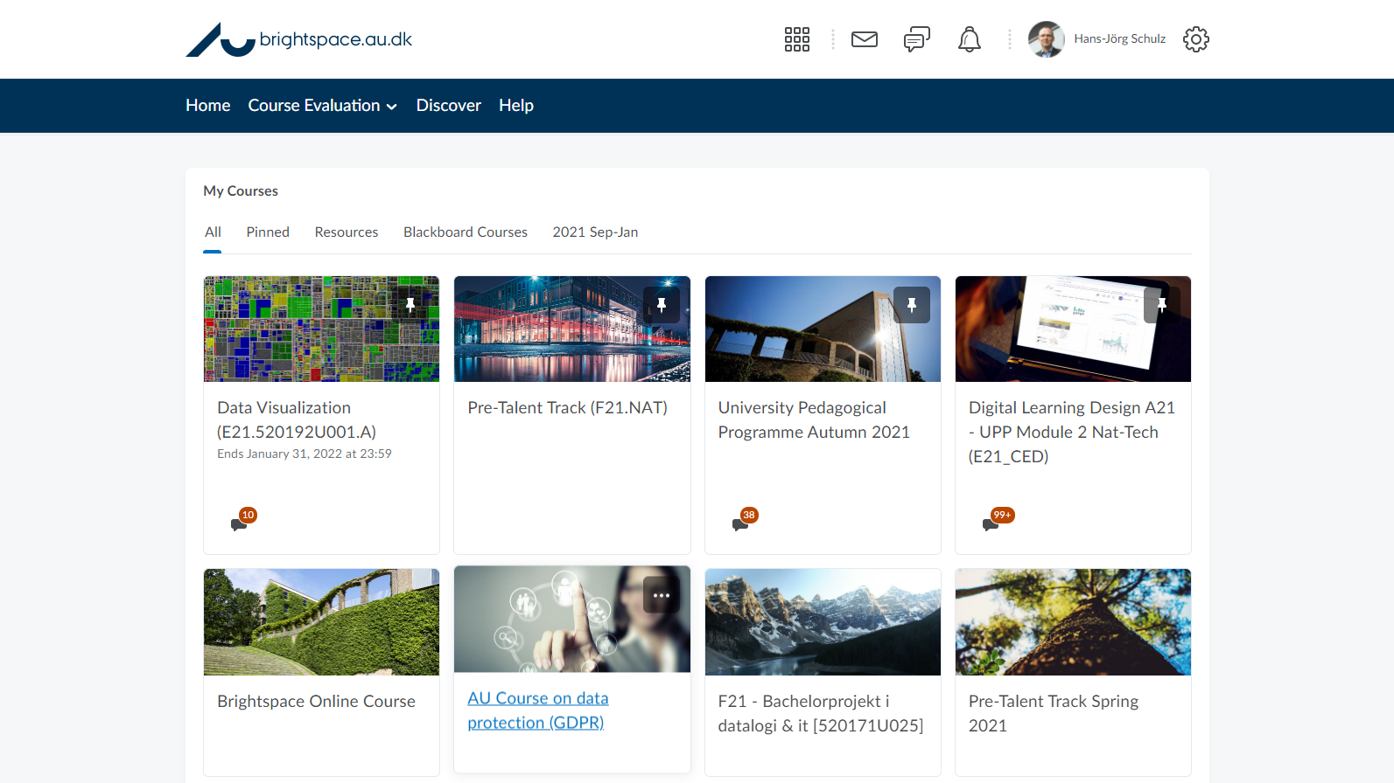

Slide 9
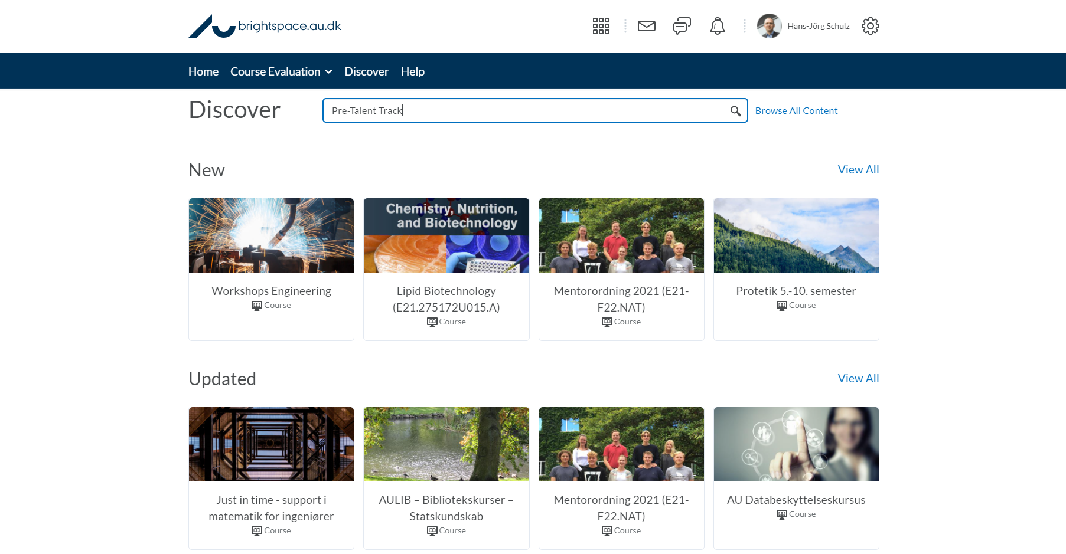
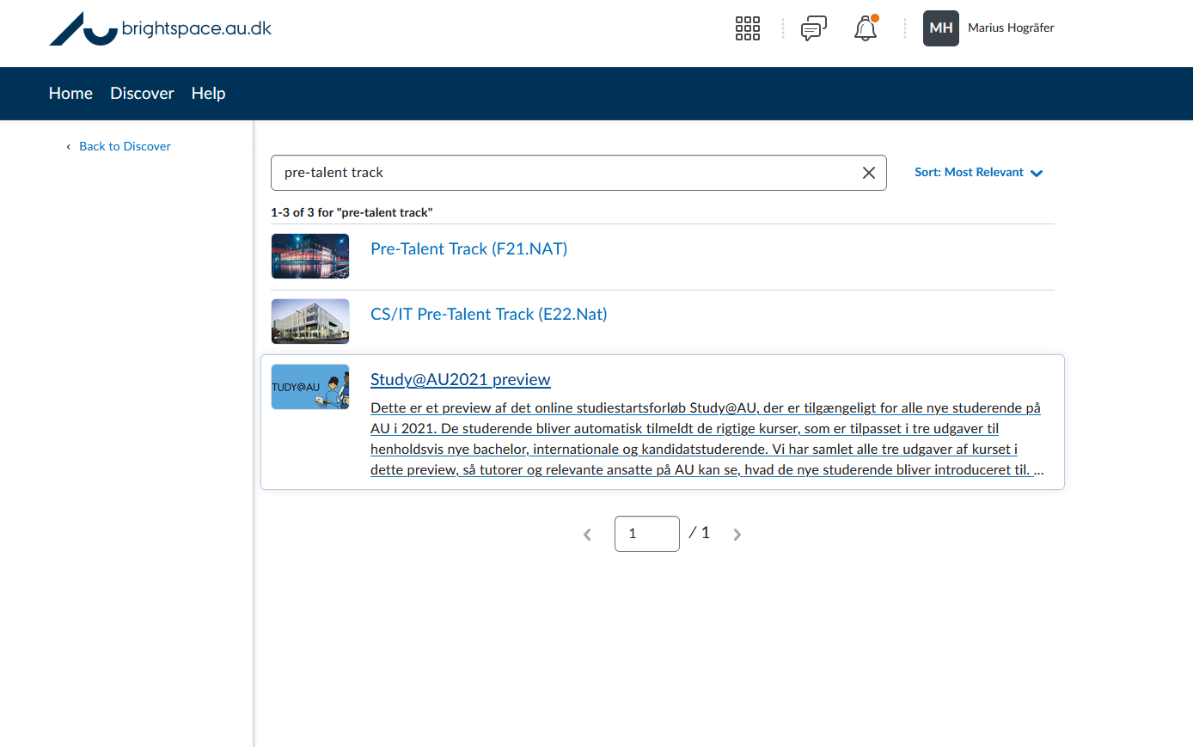

Slide 11

TALENT TRACK / Talentforløb
Purpose
Extra academic challenges for particularly talented undergraduate students
Recognition for this on diplomas (BSc with Distinction)
Process
Applied for at the beginning of the 2nd year of study
Requires grade point average of ≥10 from 1st year of study
Content
≥5 ECTS extracurricular activities per semester (project in research group)
In addition to standardized study program
Awarding a diploma requires a total of 30 ECTS extracurricular activities

Slide 12
TALENT TRACK / Talentforløb
NOW
You can take extracurricular activities already in the 1st year of study
They are credited in case of later admission to the talent program
In the fall of 2022 / spring of 2023, Pre-Talent Track is offered with 5 ECTS per semester
The most important thing is to pass the standardized study program with good grades!
Information
http://cs.au.dk/talent or hjschulz@cs.au.dk

